Slide 1

CT70A3100 Service Design
Group Assignment - Service Safari Library Service Scenario 2
Group 6
Hyechan Shin
Robert Gabrielsson
Juho Mänttäri
Amirhossein Mirsoleimani
Justyna Neuvonen
Library: Find and borrow a digital book at LUT library
Scenario 2: You like to read on your tablet or phone and want an online or digital version. Use the LUT library service to meet the scenario’s need and document the service experience

Slide 2



What they have in common?
Veronique – first year master's program student from France
Ernesto – smarty-pants, engineer with experience, first year master's program.
Antti– veteran, 6th year on master's program.
The same goal – to read a book ”Service design from insights to implementation” online!

Slide 3

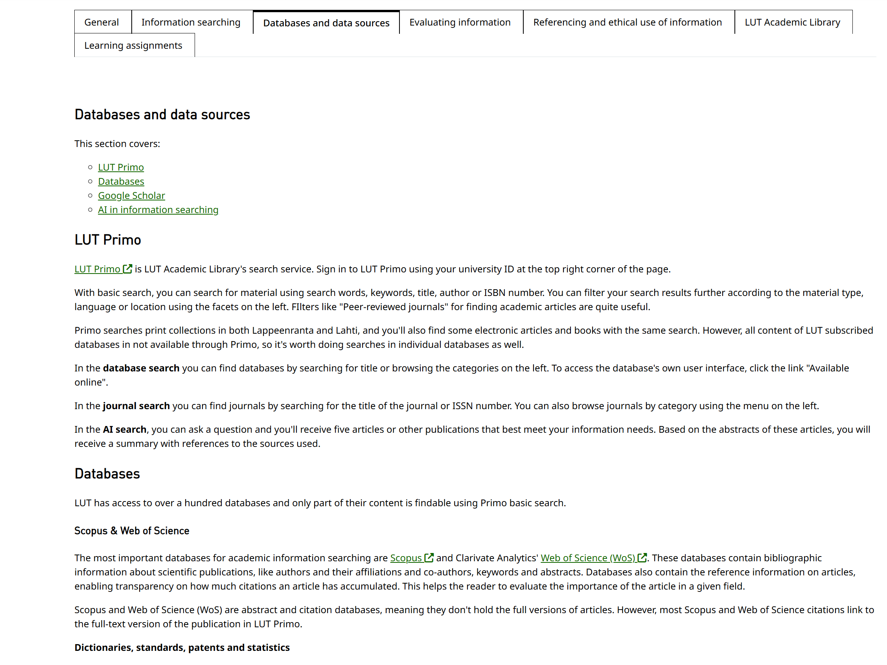
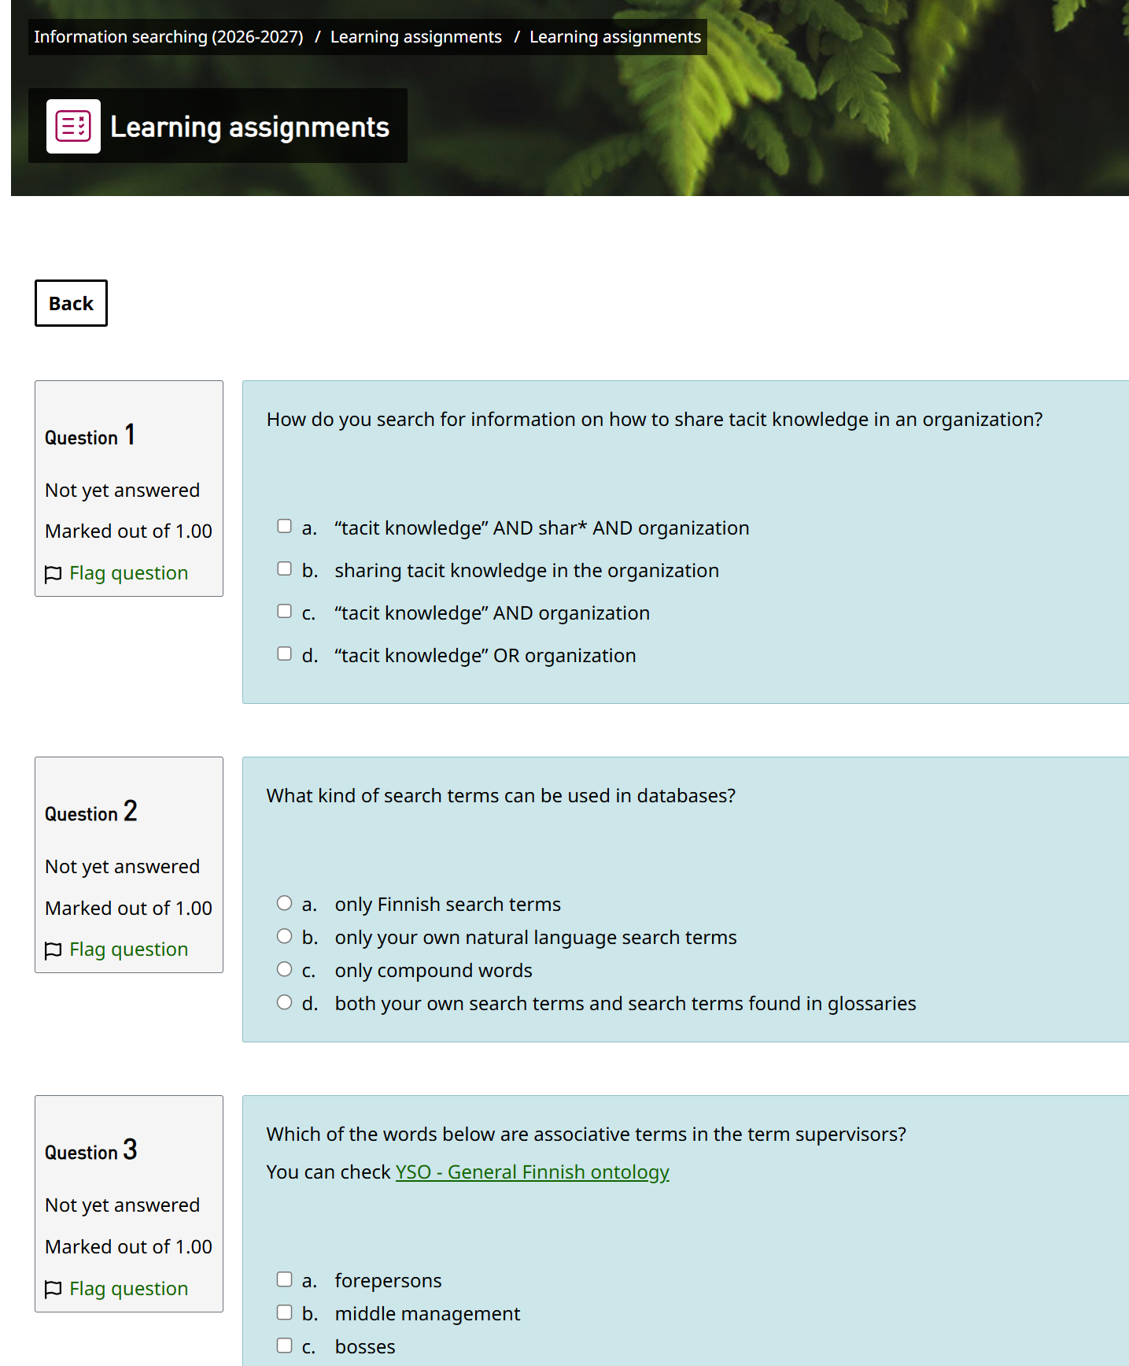

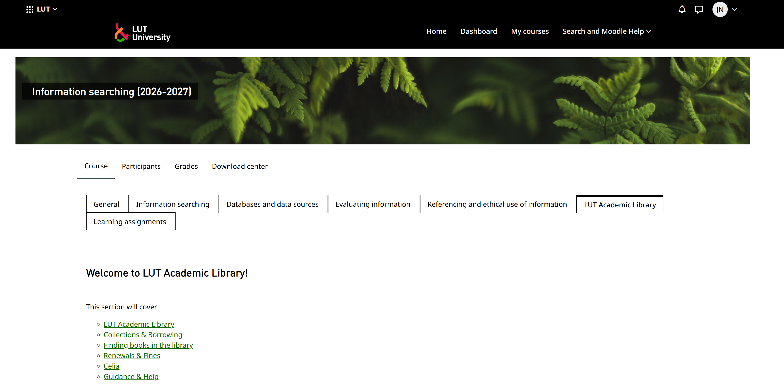
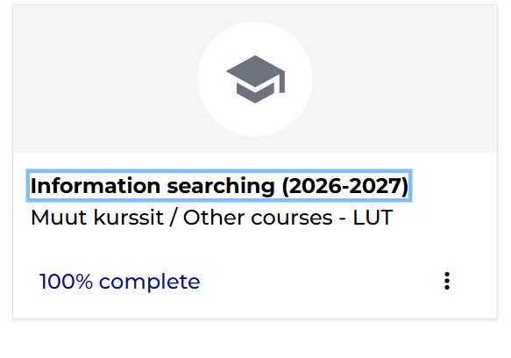
Veronique
Veronique is a good student. She saw this course on Moodle! Be like Veronique, take the Information searching course!
It was fun till the quiz...
She learned what is Primo and clicked the link to open the main page.
ME RDE

Slide 4
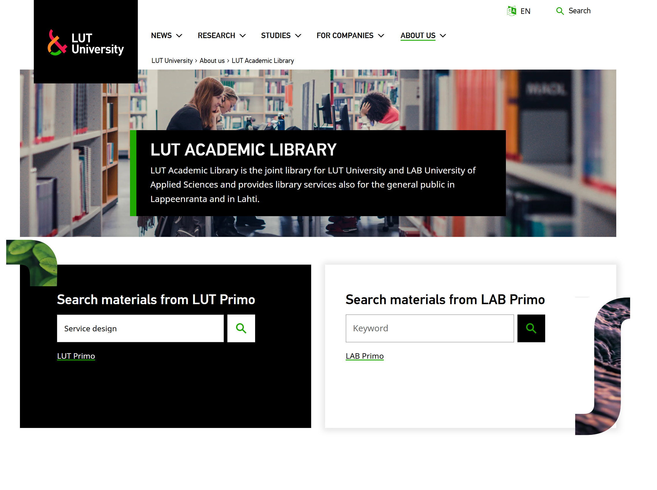
Ernesto
Ernesto decided to Google LUT Library and typed the book title on the main page of the library.

Slide 5
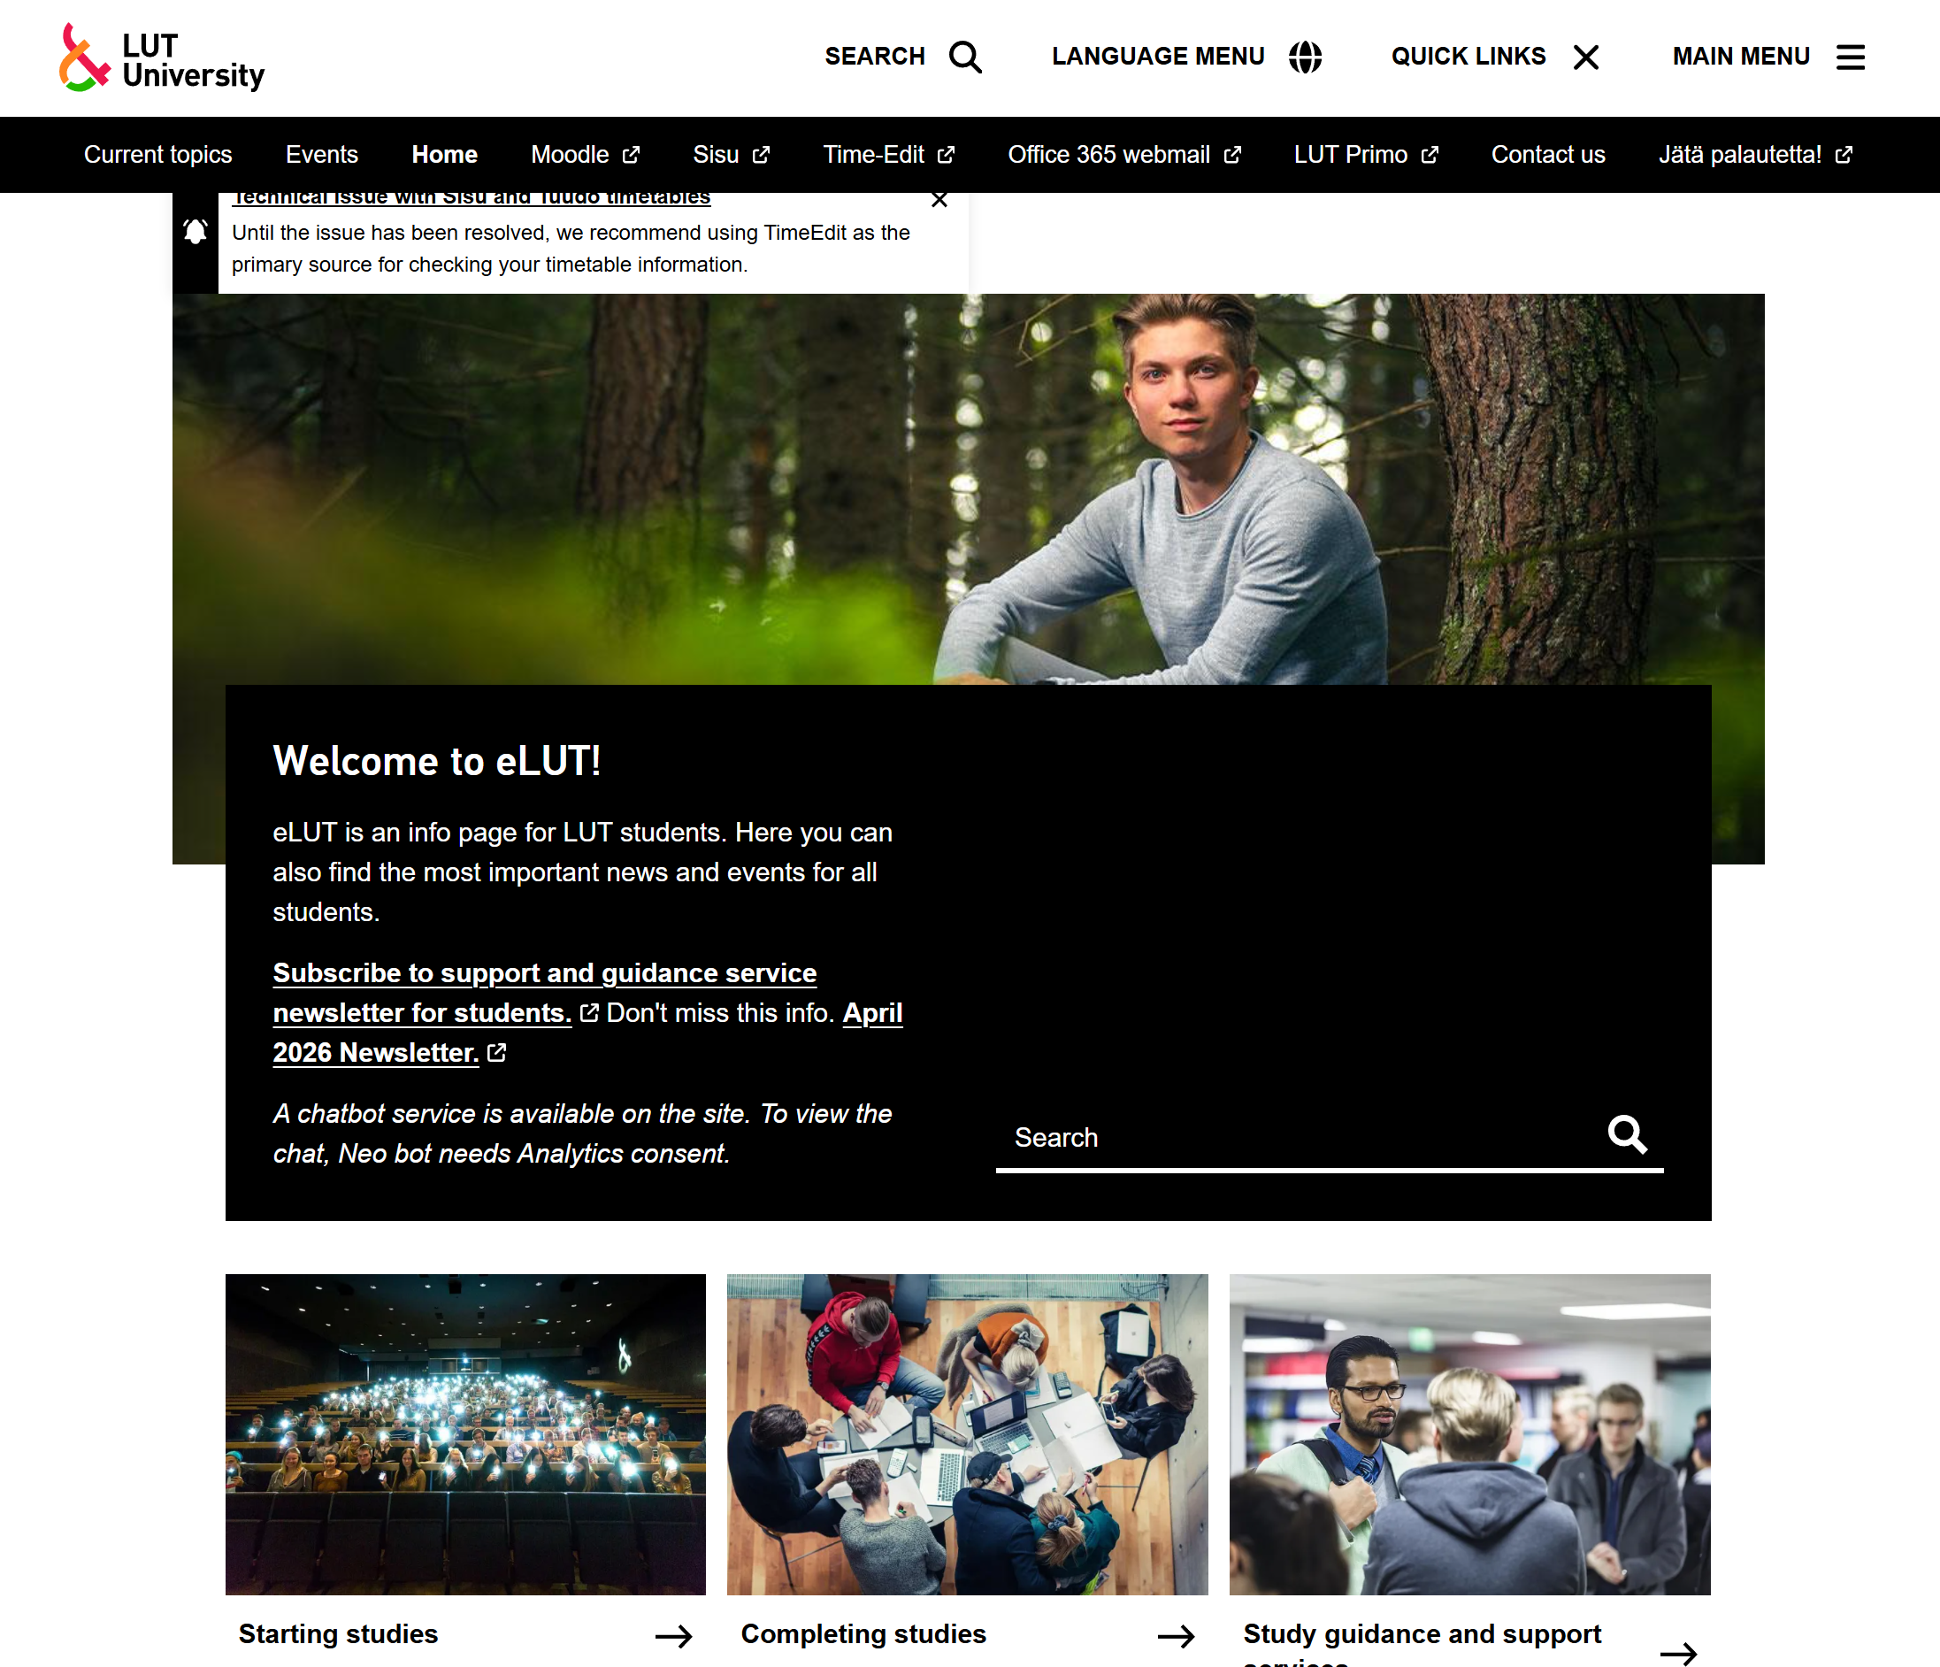
Antti
Antti, who has already been studying for six years in a master's program, went straight to the eLUT page and opened Quick Links.

Slide 6
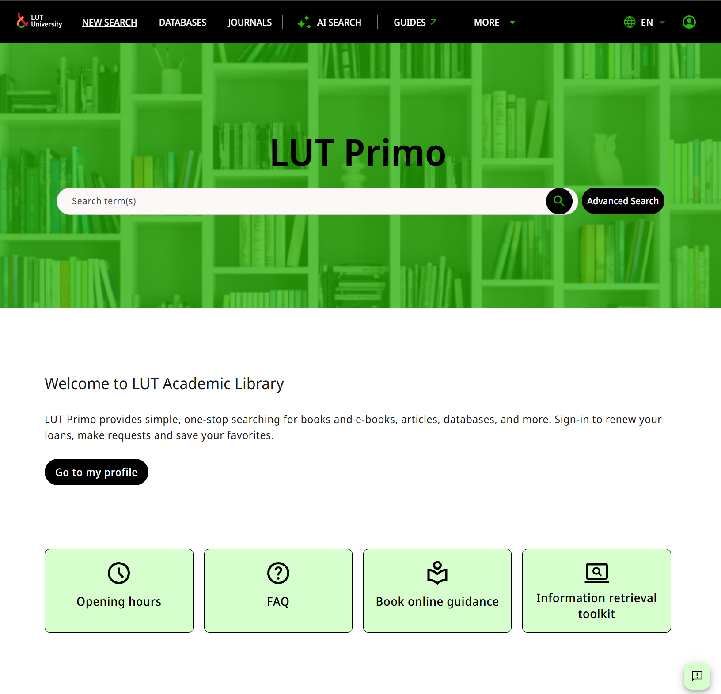
They have all managed to get to Primo log in page!
AGAIN LOGGING! UGH...
Upsista ss....
Forgot the password.
Log in? Where is my phone...

Slide 7
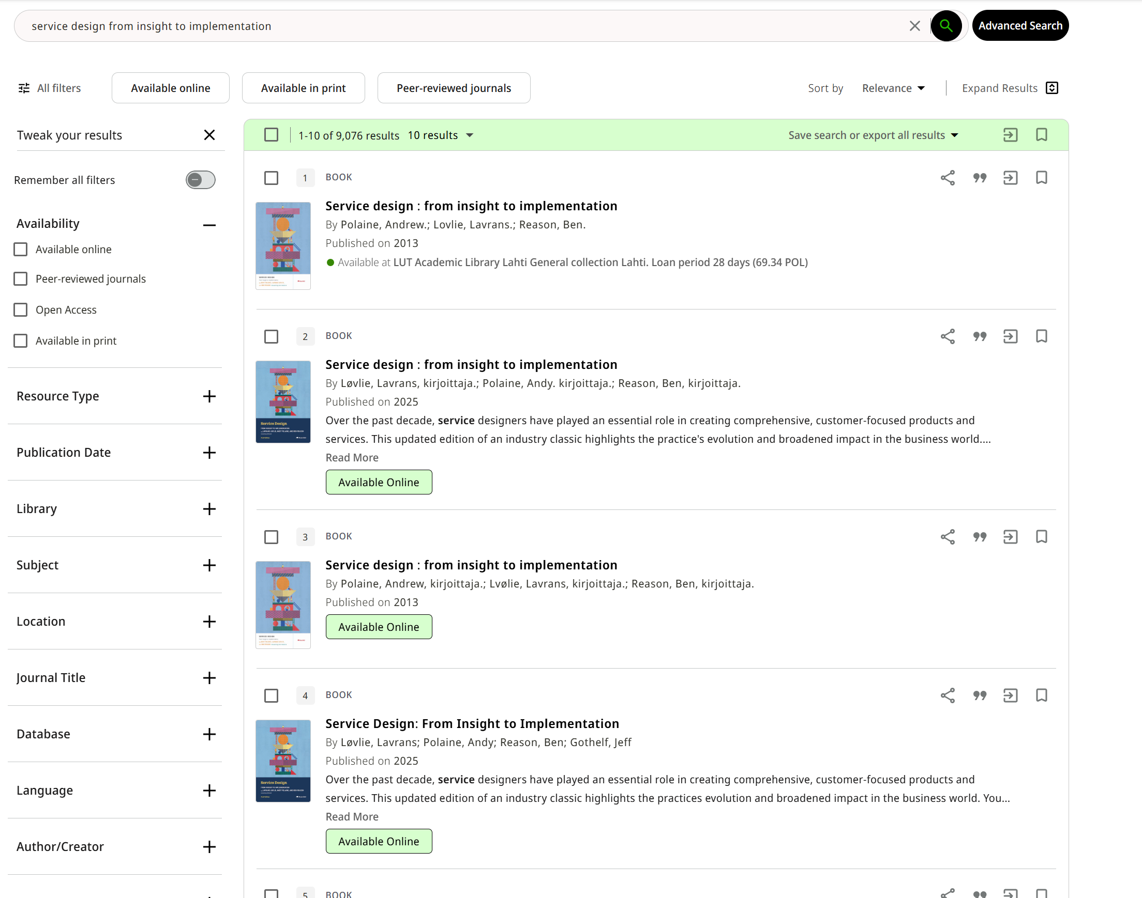
Searching for the book was easy!
CLICK!

Slide 8

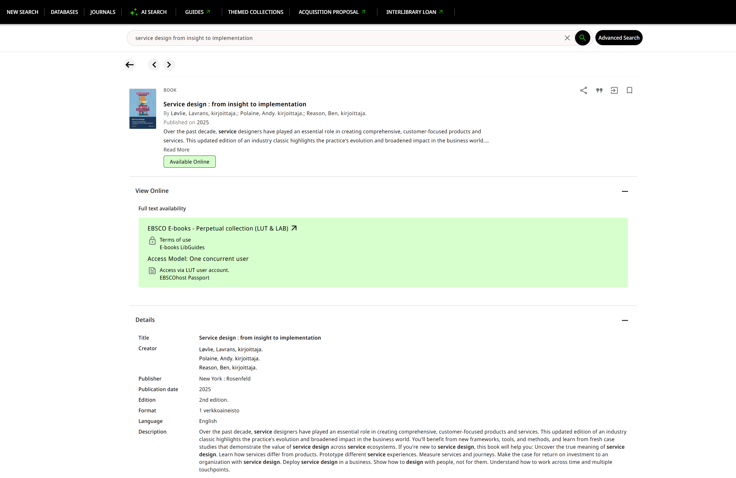
Now this is the tricky part ;)
WHAT THE
Read the name of this animal in French
CLICK!
CLICK!
CLICK!
Grrr...
CLICK!
Hey guys you need to click here...

Slide 9
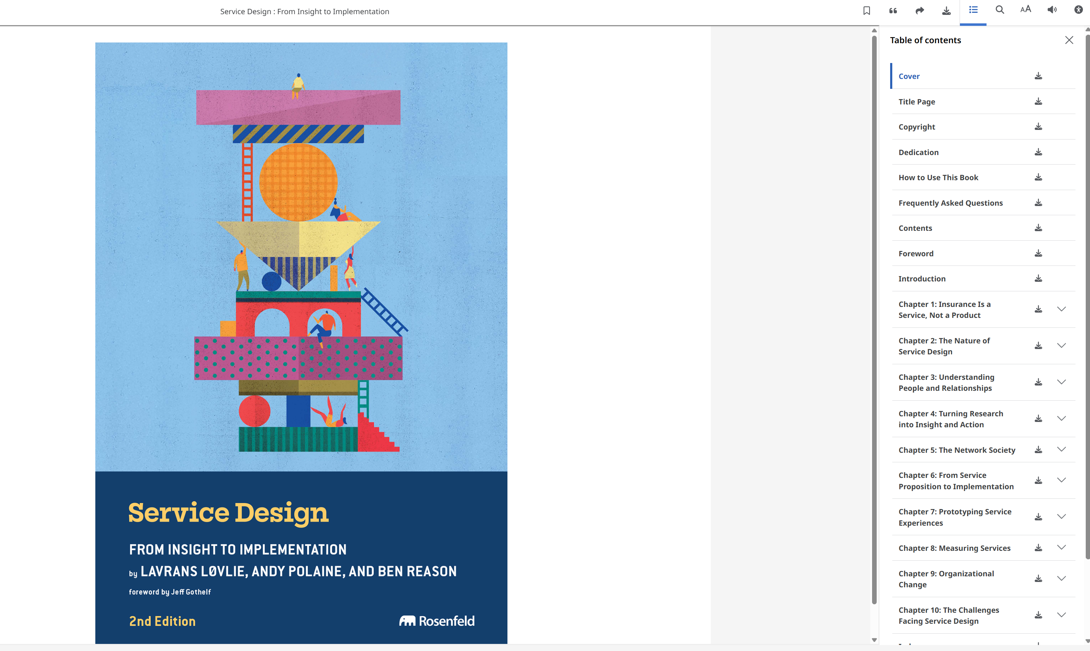
One proper click and you have it!
YAY!

Slide 10

Service is when LUT Primo allows you to borrow from a selection of books and medias in the medium that suits you best, in our case it was digital.
After all, everyone is happy because nobody needs to buy expensive books.
Different users, different paths, the same outcome.

